Slide 1
Operating System Structures
CSC 322: Operating Systems Concept

Slide 2
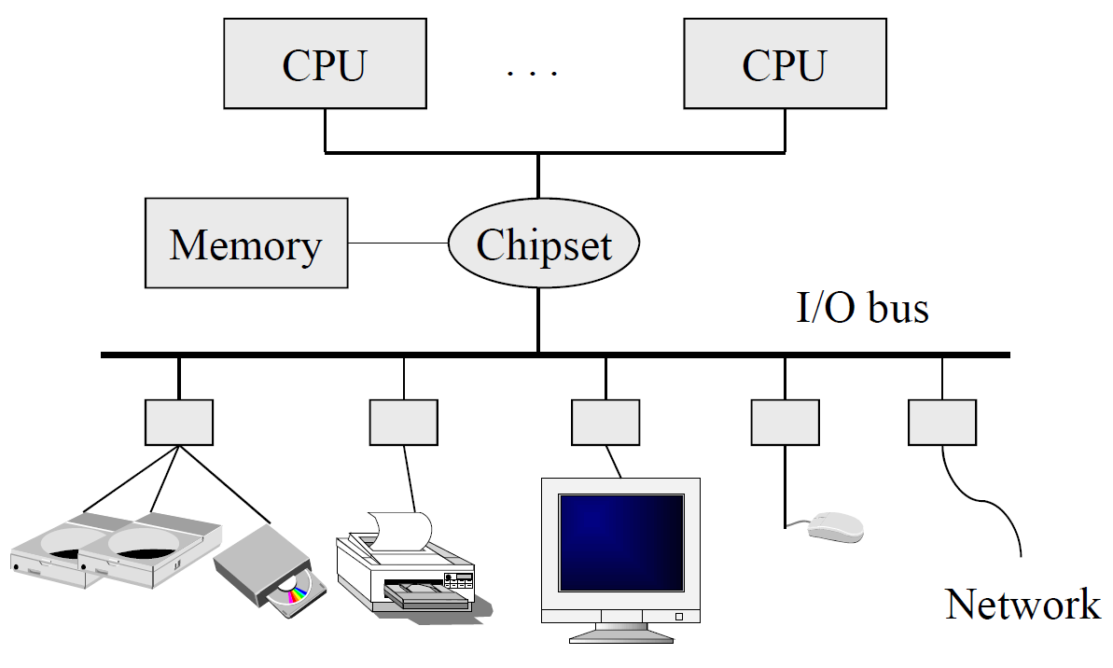
A Typical Computer from a Hardware Point of View

Slide 3
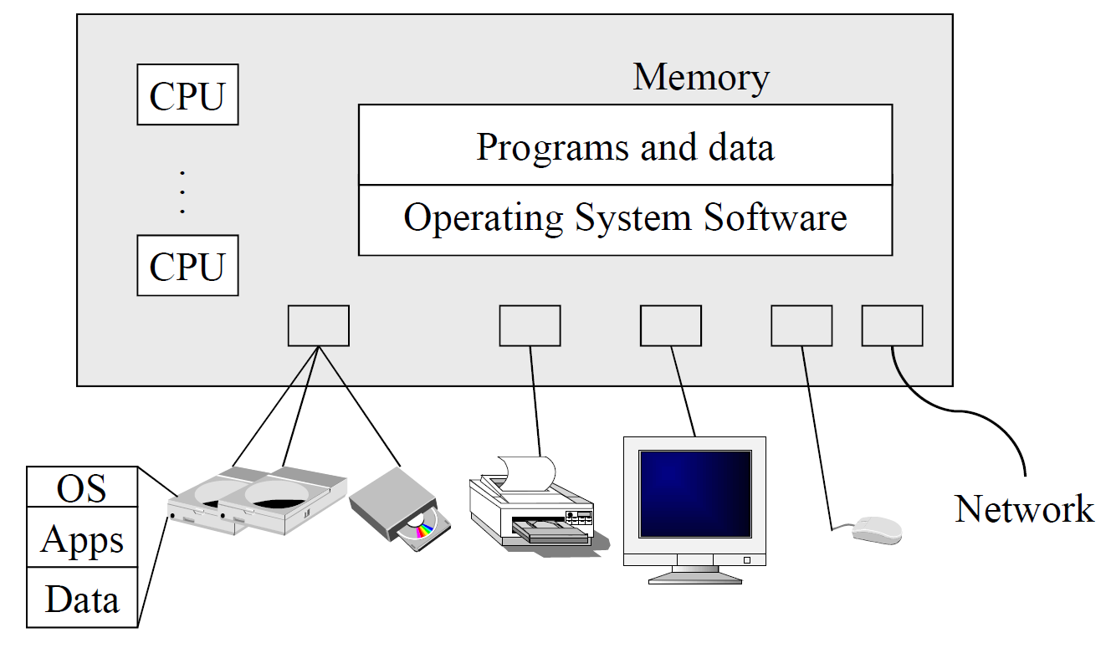
A Typical Computer System

Slide 4
Typical OS Structure
Written by programmer
Compiled by programmer Uses library calls
Applications
Written by gurus
Provided pre-compiled Interface defined in headers
Invoked like functions
Input to linker (compiler)
Maybe “resolved” when
program is loaded
Libraries
Machine-Dependent Layer
Portable OS Layer
“Guts” of system calls
All “high-level” code
Bootstrap
System Initialization
I/O device driver
Kernel/user mode switching
Interrupt and exception
Process management

Slide 5
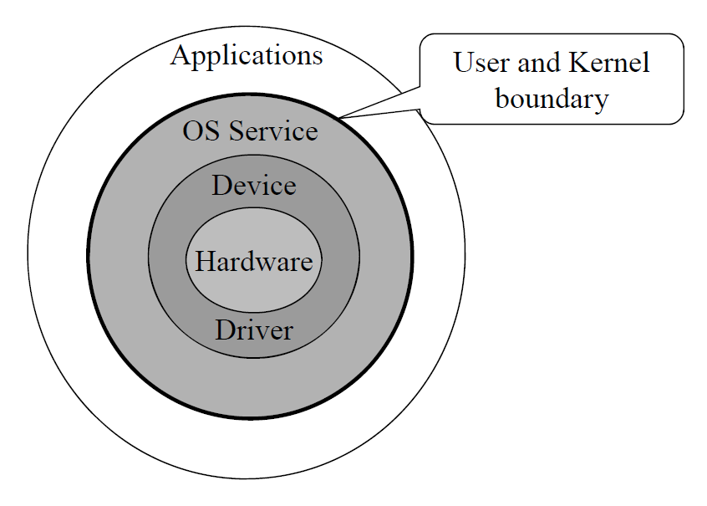
Another Look: Unix “Onion”

Slide 6
Operating System Kernel
A kernel is a central component of an operating system and is the one program running at all times. Everything else is either a system program or an application program.
Classified mainly into two categories
Monolithic (Mono means single, Lithic means layer)
Micro Kernel

Slide 7
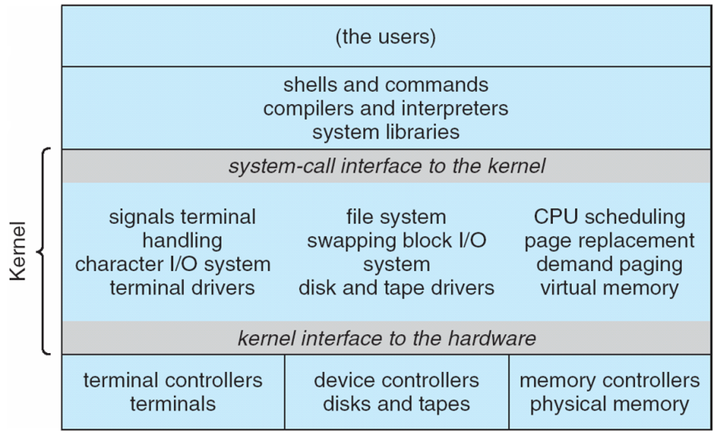
Monolithic Kernel
An old approach where basic system services like process and memory management, interrupt handling etc. were packed into a single module in kernel space
Size was huge,
Poor maintainability (bug fixing and addition of new features resulted in recompilation of the whole kernel code which could consume hours.
E.g. MS-DOS

Slide 8
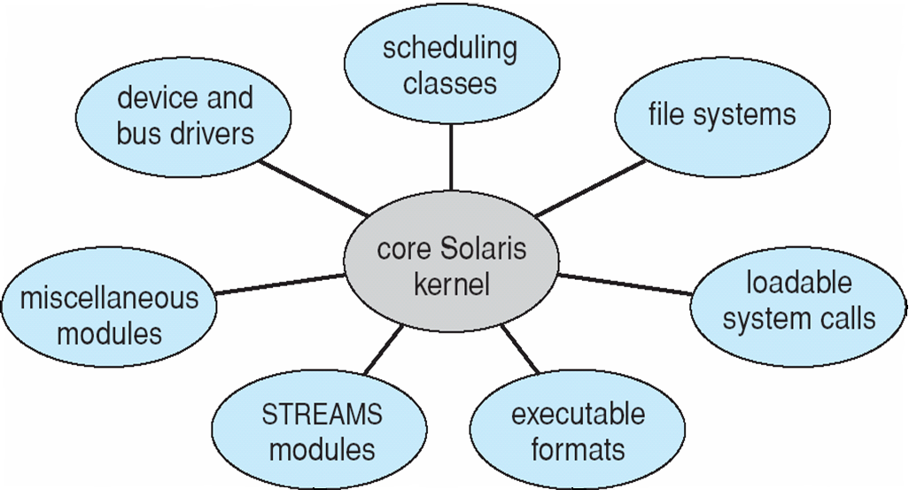
Micro Kernel
Modular Approach: Moves as much from the kernel into user space
Different modules can be dynamically loaded/un-loaded.
Easy extension of OS’s capabilities.
Easily maintainable as only the concerned module needs to be loaded and unloaded every time if there is change or bug fix in a particular module
Reduced kernel size increases the security and stability of OS e.g., if network service crashes due to buffer overflow, then only the networking services memory would be corrupted, leaving the rest of the system still functional.

Slide 9
System Programs
Background Services
Launch at boot time
Some for system startup, then terminate
Some from system boot to shutdown
Provide facilities like disk checking, process scheduling, error logging
Run in user context not kernel context
Known as services, subsystems, daemons
Application programs
Does not pertain to system
Run by users
Not typically considered part of OS
Launched by command line, mouse click, finger poke

Slide 10
Operating-System Debugging
Debugging is finding and fixing errors, or bugs
OS generate log files containing error information
Failure of an application can generate core dump file capturing memory of the process
Operating system failure can generate crash dump file containing kernel memory
Beyond crashes, performance tuning can optimize system performance
Sometimes using trace listings of activities, recorded for analysis
Profiling is periodic sampling of instruction pointer to look for statistical trends
Kernighan’s Law: “Debugging is twice as hard as writing the code in the first place. Therefore, if you write the code as cleverly as possible, you are, by definition, not smart enough to debug it.”

Slide 11
Operating System Components
Process Management
Main-Memory Management
Secondary-Storage Management
File Management
I/O System Management
Networking
Command-Interpreter System

Slide 12
Process Management
A process is a program in execution
Process is active, program is passive
A process needs resources to accomplish its tasks:
CPU time, Memory, Files, I/O devices
The OS is responsible for:
Process creation and deletion (Allocation & reclaim of reusable resources)
Process suspension and resumption
Providing mechanisms for process synchronization
Providing mechanisms for process communication
Providing mechanisms for deadlock detection and handling

Slide 13
Main-Memory Management
Memory: a volatile storage device, shared by the CPU and I/O devices
The OS is responsible for:
Allocate and free memory space as needed
Keep track of which parts of memory are currently being used and by whom
Deciding which processes (or parts) and data to move into and out of memory
Optimizing CPU utilization and computer response to users
Protection
How to do it fast?
Support larger address space than physical memory

Slide 14
Secondary-Storage Management
Main Memory (primary storage) is volatile and small → OS needs a secondary storage to back up main memory
Most Modern systems use disks as the principle on-line storage medium
The OS is responsible for:
Allocating/freeing disk storage
Disk scheduling

Slide 15
I/O subsystem Management
I/O devices of many flavors
Storage devices: drives, tapes
Transmission devices: NIC, modems
Human-interface devices: screen, keyboard, mouse
I/O subsystems hides peculiarities of I/O devices
The I/O subsystem consists of:
A general device-driver interface (wrapper)
Drivers for specific hardware devices
Buffering/spooling/caching (access locality)

Slide 16
File Management
A file is a logical entity
It is a collection of related information defined by its creator
The OS is responsible for:
File and directory creation and deletion
Mapping files onto secondary storage
Support of primitives for manipulating files and directories (e.g. ls)
Sharing and protection

Slide 17
Networking (distributed systems)
A distributed system:
A collection of machines that do not share memory or a clock
Provides user access to various system resources through a network
Example: WWW, banking, peer-to-peer, Internet …
Allows computation speedup, increased data availability, reliability
The OS is responsible for:
Communication between processes on the same system or over a network
Reliability – reliable protocols

Slide 18
Command-Interpreter System
The program that reads and interprets control statements is called command-line interpreter (or the shell in UNIX)
Interface between user and OS
Many commands are given to the OS by control statements which deal with
Process creation and management (a.out, kill -9)
Secondary-Storage management (partition disk)
File system
Access (ls, cat)
Protection (chmod 700 *, unmask 077)
Networking (telnet, ssh)
Monitoring (top, vmstat, netstat)
Sometimes implemented in kernel, sometimes by systems program
Sometimes commands built-in, sometimes just names of programs
If the latter, adding new features doesn’t require shell modification

Slide 19
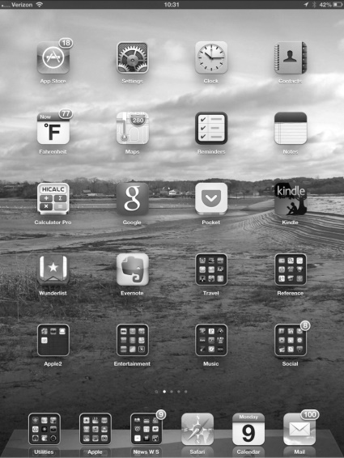
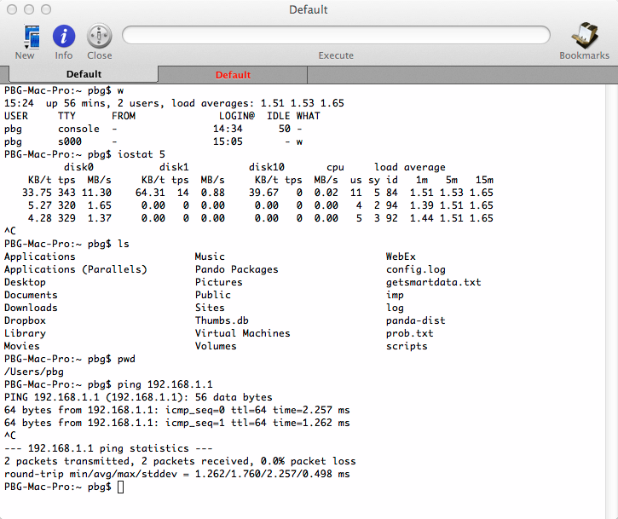
Command-Interpreter System
Wide range of different approaches to the interface
Mouse-based windows-and-menus (Mac, Windows)
Command line (UNIX)
Touchscreen (Mobile devices)
Voice Commands
Many systems now include both CLI and GUI interfaces
Microsoft Windows is GUI with CLI “command” shell
Apple Mac OS X is “Aqua” GUI interface with UNIX kernel underneath and shells available
Unix and Linux have CLI with optional GUI interfaces (CDE, KDE, GNOME)

Slide 20
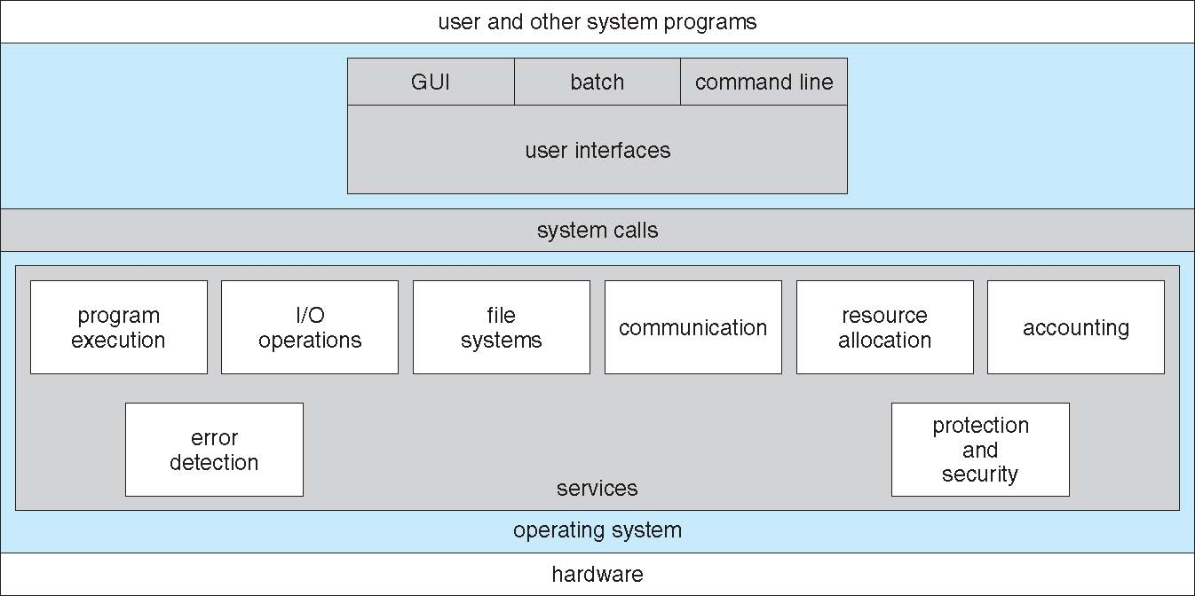
A View of Operating System Services

Slide 21
Dual-Mode Operation
OS manages shared resources
OS protects programs from other programs
OS needs to be “privileged”
Dual-mode operation of hardware
Kernel-mode → can run privileged instructions
User-mode → can only run non-privileged instructions

Slide 22
Typical OS Structure
Applications
Libraries
User level
Kernel level
Machine-Dependent Layer
Portable OS Layer

Slide 23
Dual-Mode Operation
OS manages shared resources
OS protects programs from other programs
OS needs to be “privileged”
How does a user program request for accessing shared resources
E.g. hard drive

Slide 24
System Calls
Interface between a process and the operating system kernel
Kernel manages shared resources & exports interface
Process requests for access to shared resources
Generally available as assembly-language instructions
Directly invoked in many languages (C or C++, Perl) via a high-level Application Programming Interface (API) rather than direct system call use
Who is helping out here?
Notes:
System calls Mostly accessed by programs via a high-level Application Program Interface (API) rather than direct system call use
System calls differ from platform to platform. By using a stable API, it is easier to migrate your software to different platforms.

Slide 25
Typical OS Structure
Applications
Written by gurus
Provided pre-compiled Interface defined in headers
Invoked like functions
Input to linker (compiler)
Maybe “resolved” when
program is loaded
Libraries
Machine-Dependent Layer
Portable OS Layer

Slide 26
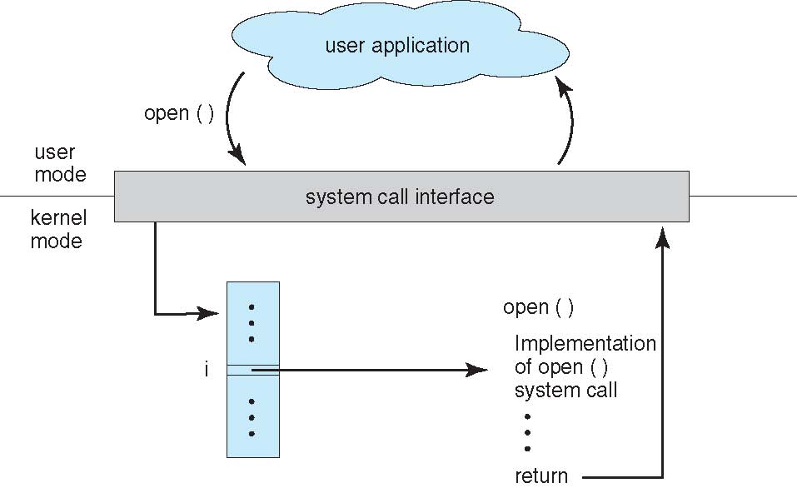
Example
Given the I/O instructions are privileged, how does the user program perform I/O?
open( )
read( )
write( )
close( )

Slide 27
System Calls
Categories
Process management
Memory management
File management
Device management
Networking
Notes:
System calls Mostly accessed by programs via a high-level Application Program Interface (API) rather than direct system call use
System calls differ from platform to platform. By using a stable API, it is easier to migrate your software to different platforms.

Slide 28
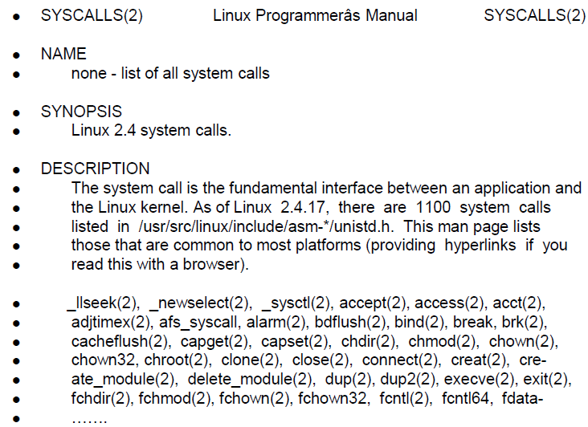
System Calls in Linux (man syscalls)
Notes:
System calls Mostly accessed by programs via a high-level Application Program Interface (API) rather than direct system call use
System calls differ from platform to platform. By using a stable API, it is easier to migrate your software to different platforms.

Slide 29
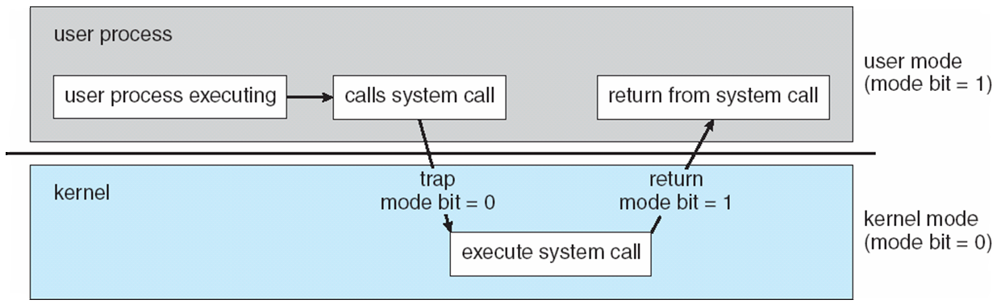
Transition from User to Kernel Mode

Slide 30
System Call Implementation
Typically, a number associated with each system call
System-call interface maintains a table indexed according to these numbers
The system call interface invokes intended system call in OS kernel and returns status of the system call and any return values
The caller need know nothing about how the system call is implemented
Just needs to obey API and understand what OS will do as a result call
Most details of OS interface hidden from programmer by API
Managed by run-time support library (set of functions built into libraries included with compiler)

Slide 31
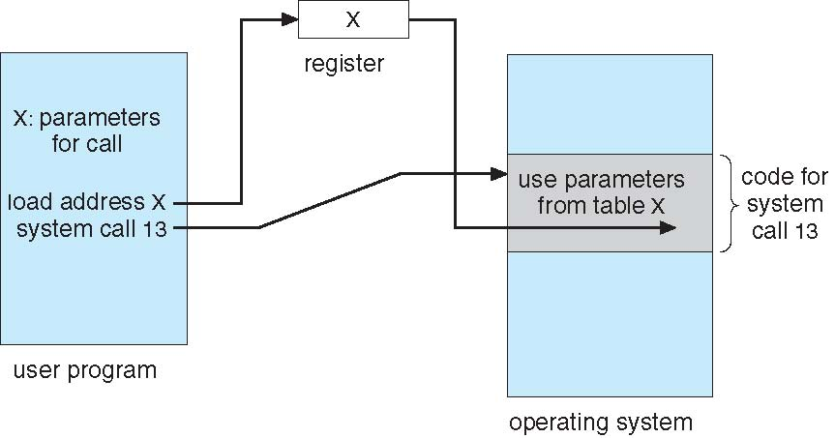
System Call Parameter Passing
Some system calls require additional information that is passed as parameters
Three general methods used to pass parameters to the OS
Simplest: pass the parameters in registers
In some cases, may be more parameters than registers
Parameters stored in a block, or table, in memory, and address of block passed as a parameter in a register (Linux and Solaris)
Parameters pushed onto the stack by the program and popped off the stack by the operating system
Block and stack methods do not limit the number or length of parameters being passed

Slide 32
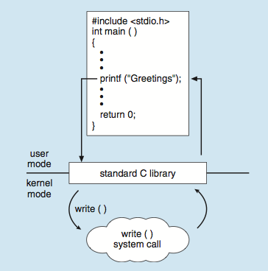
Standard C Library Example
C program invoking printf() library call, which calls write() system call

Slide 33
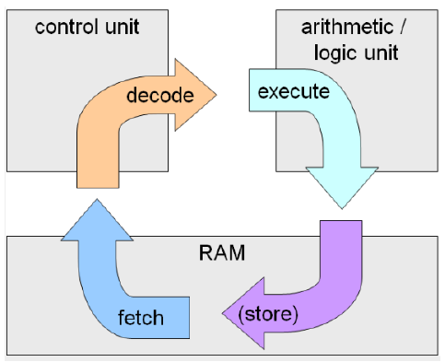
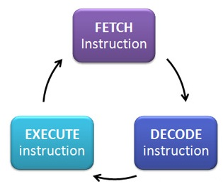
Instruction Execution(IE)
Once a program is in memory it has to be executed. To do this, each instruction must be looked at, decoded and acted upon in turn until the program is completed. This process is known as “instruction execution cycle”
At the beginning of each instruction cycle, CPU fetches instruction from memory.
PC holds the address of the next instruction to be executed.
The fetched instruction is loaded into IR.

Slide 34
Concurrency & Unexpected Events
How to human handle unexpected events?
Assume
mail is delivered to my mailbox continuously
I have a secretary
Do I have a mail now? (need to be processed quickly)
Poll vs. interrupt
Which one is more efficient?
Assume 1 interrupt more costly than 1 poll
If I have one mail per day?
If I have lots of mail per delivery?

Slide 35
Interrupt
A mechanism for:
coordination between concurrently operating units of a computer system (e.g. CPU and I/O devices)
for responding to specific conditions within a processor
Results in transfer of flow of control (to interrupt handler in the OS)
forced by hardware

Slide 36
Two types of Interrupts
Hardware Interrupts
timers
keyboards, NICs, etc. (I/O devices)
Software Interrupts (aka trap, exception)
An error (floating point exception)
A system call requesting OS for special services (e.g. I/O)

Slide 37
Handling Interrupts
Incoming interrupts are disabled (at this and lower priority levels) while the interrupt is being processed to prevent a loss interrupt
Instruction architecture must save the address of the interrupted instruction
Interrupt transfers control to the interrupt service routine generally, through the interrupt vector, which contains the addresses of all the service routines
If interrupt routing modifies process state (register values)
save current state of the CPU (registers and program counter) on the system stack
restore before returning
Interrupts are re-enabled after servicing current interrupt
Resume the interrupted instruction

Slide 38
Handling Interrupts
What happens if while handling an interrupt, another interrupt triggers?
It can be handled using two approaches
Sequential approach
Nested approach

Slide 39
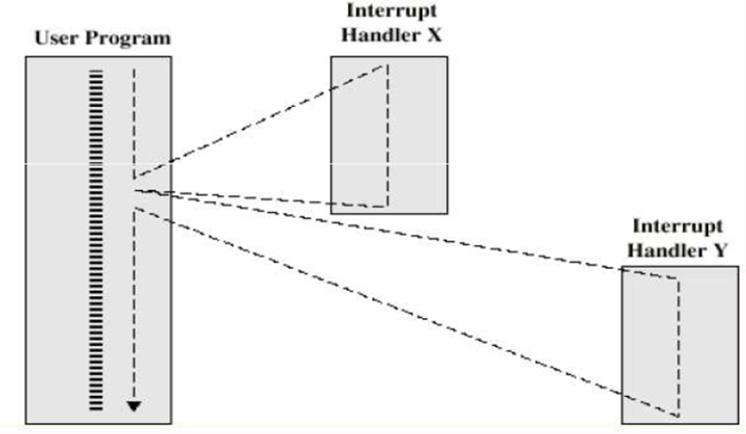
Sequential Interrupt Handling

Slide 40
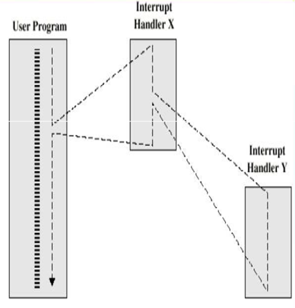
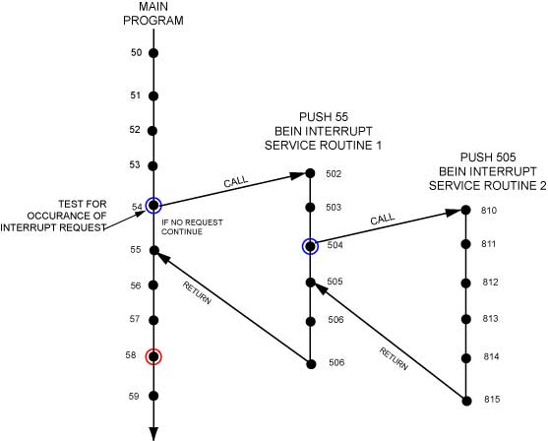
Nested Interrupt Handling

Slide 41
“Modern OS are interrupt driven”
“An OS handles interrupts”
Timer interrupt → Context switches in multiprogramming
(unexpected) I/O interrupts
System calls (traps) to switch from user to supervisor mode
At the lowest level OS is just a bunch of interrupts service routings
Each routine simply returns to whatever was executing before it was interrupted
A user process
An OS process
Another interrupt routine
Else infinite wait loop

